Slide 1
Issues and model Multiscale Memory requirement studies

Slide 2
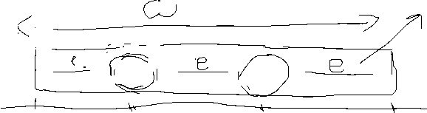



Pregunta como distribuir celulas uniformemente en una linea? (1)
Si las celulas no cubren toda la linea -> espacios en blanco tienen que tener igual distancia
$x_{0}=\left(w−2rN\right)/\left(N+1\right)+r=\frac{w−\left(N−1\right)r}{N+1}=\frac{w+2r}{N+1}−r$
$w$ es la longitude del segment
$r$ es el radio de la celula
$N$ es el numero de celulas
$d=(w−2x_{0})/(N−1)$
$x_{i}=x_{0}+di$
Observar que cuando $N→∞⇒x→−r$, ademas observando pimer y ultima ecuacion obsevamos que ${|x}_{0}|≤r$ cuando $w≤2rN$

Slide 3
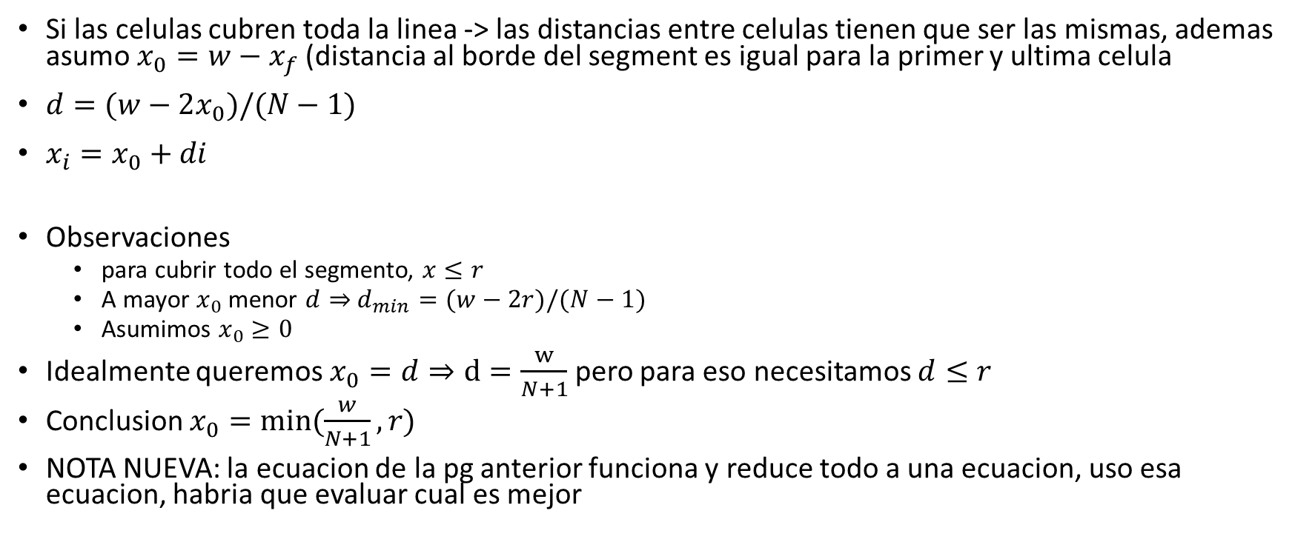
Pregunta como distribuir celulas uniformemente en una linea? (2)
Si las celulas cubren toda la linea -> las distancias entre celulas tienen que ser las mismas, ademas asumo $x_{0}=w−x_{f}$ (distancia al borde del segment es igual para la primer y ultima celula
$d=(w−2x_{0})/(N−1)$
$x_{i}=x_{0}+di$
Observaciones
para cubrir todo el segmento, $x≤r$
A mayor $x_{0}$ menor $d⇒$ $d_{min}=(w−2r)/(N−1)$
Asumimos $x_{0}≥0$
Idealmente queremos $x_{0}=d⇒d=\frac{w}{N+1}$ pero para eso necesitamos $d≤r$
Conclusion $x_{0}=min⁡(\frac{w}{N+1},r)$
NOTA NUEVA: la ecuacion de la pg anterior funciona y reduce todo a una ecuacion, uso esa ecuacion, habria que evaluar cual es mejor

Slide 4
Pregunta como distribuir celulas uniformemente en una linea? (3)

Slide 5
Issue 1: How to place PCs
Objective:
We have k scales of representation
We have a total number of cells N
We want to choose the distribution of cell sizes size freely
We want to distribute cells uniformly in space ideally in recangular grid
Problem:
Distributing cells in a rectangular grid restricts the number of cells that can be placed on it which does not allow us to choose N and the distribution freely.
For example, in a square environment, placing cells uniformly distributed on a rectangular grid required that the number of cells in that layer be a perfect square.

Slide 6
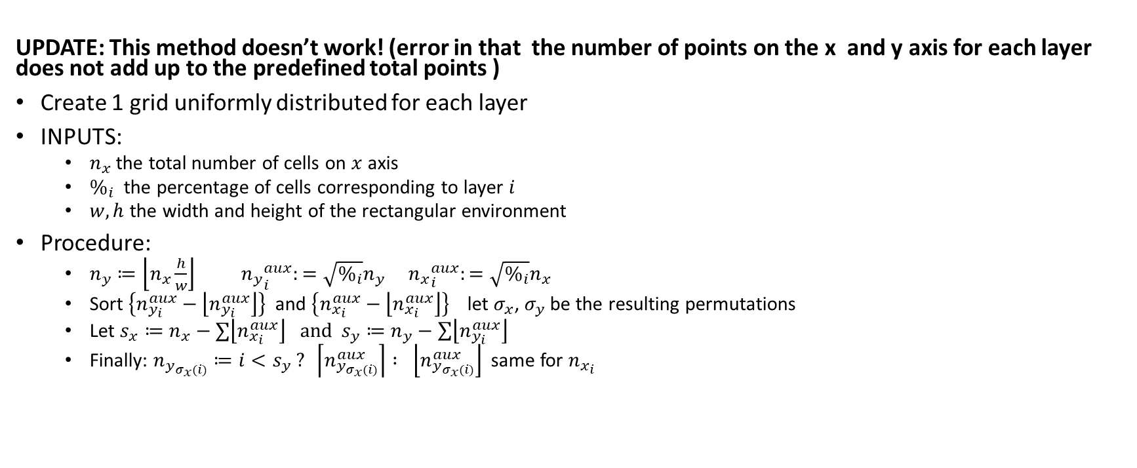
Issue 1 – Possible Method 1 (1)
UPDATE: This method doesn’t work! (error in that the number of points on the x and y axis for each layer does not add up to the predefined total points )
Create 1 grid uniformly distributed for each layer
INPUTS:
$n_{x}$ the total number of cells on $x$ axis
$\%_{i}$ the percentage of cells corresponding to layer $i$
$w,h$ the width and height of the rectangular environment
Procedure:
$n_{y}≔\left\lfloor n_{x}\frac{h}{w}\right\rfloor$ ${n_{y}}_{i}^{aux}:=\sqrt{\%_{i}}n_{y}$ ${n_{x}}_{i}^{aux}:=\sqrt{\%_{i}}n_{x}$
Sort $\left\{n_{y_{i}}^{aux}−\left\lfloor n_{y_{i}}^{aux}\right\rfloor \right\}$ and $\left\{n_{x_{i}}^{aux}−\left\lfloor n_{x_{i}}^{aux}\right\rfloor \right\}$ let $σ_{x}$, $σ_{y}$ be the resulting permutations
Let $s_{x}≔n_{x}−∑\left\lfloor n_{x_{i}}^{aux}\right\rfloor \text{and} s_{y}≔n_{y}−\sum{\left\lfloor n_{y_{i}}^{aux}\right\rfloor }$
Finally: $n_{y_{σ_{x}(i)}}≔i<s_{y} ? \left\lceil n_{y_{σ_{x}(i)}}^{aux}\right\rceil : \left\lfloor n_{y_{σ_{x}(i)}}^{aux}\right\rfloor$ same for $n_{x_{i}}$

Slide 7
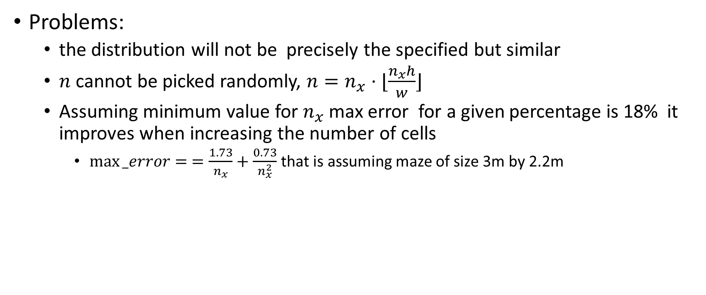
Issue 1 - Possible method 1 (2)
Problems:
the distribution will not be precisely the specified but similar
$n$ cannot be picked randomly, $n=n_{x}⋅⌊\frac{n_{x}h}{w}⌋$
Assuming minimum value for $n_{x}$ max error for a given percentage is 18% it improves when increasing the number of cells
$\max{_error}= =\frac{1.73}{n_{x}}+\frac{0.73}{n_{x}^{2}}$ that is assuming maze of size 3m by 2.2m

Slide 8
Issue 1 – possible method 2
Create a single rectangular grid for all cells
For each center choose radii
Choose so that numbers reflect distribution
How to choose?
Randomly according to distribution
problems:
Cannot guarantee bound in error
Cannot guarantee good placement of cells
Must make multiple runs with different seeds to reduce biases
Place them in size order (bigger first), define force between walls and PC centers and between PC centers. Start with random placement then minimize net force on centers. Same can be applied but without placing a grid. Repeat with lower size cells and remaining grid spots

Slide 9
Issue 1 – possible method 3
Generate Fibonacci spiral for each size, then scale to fit maze
Nice, but does not work

Slide 10
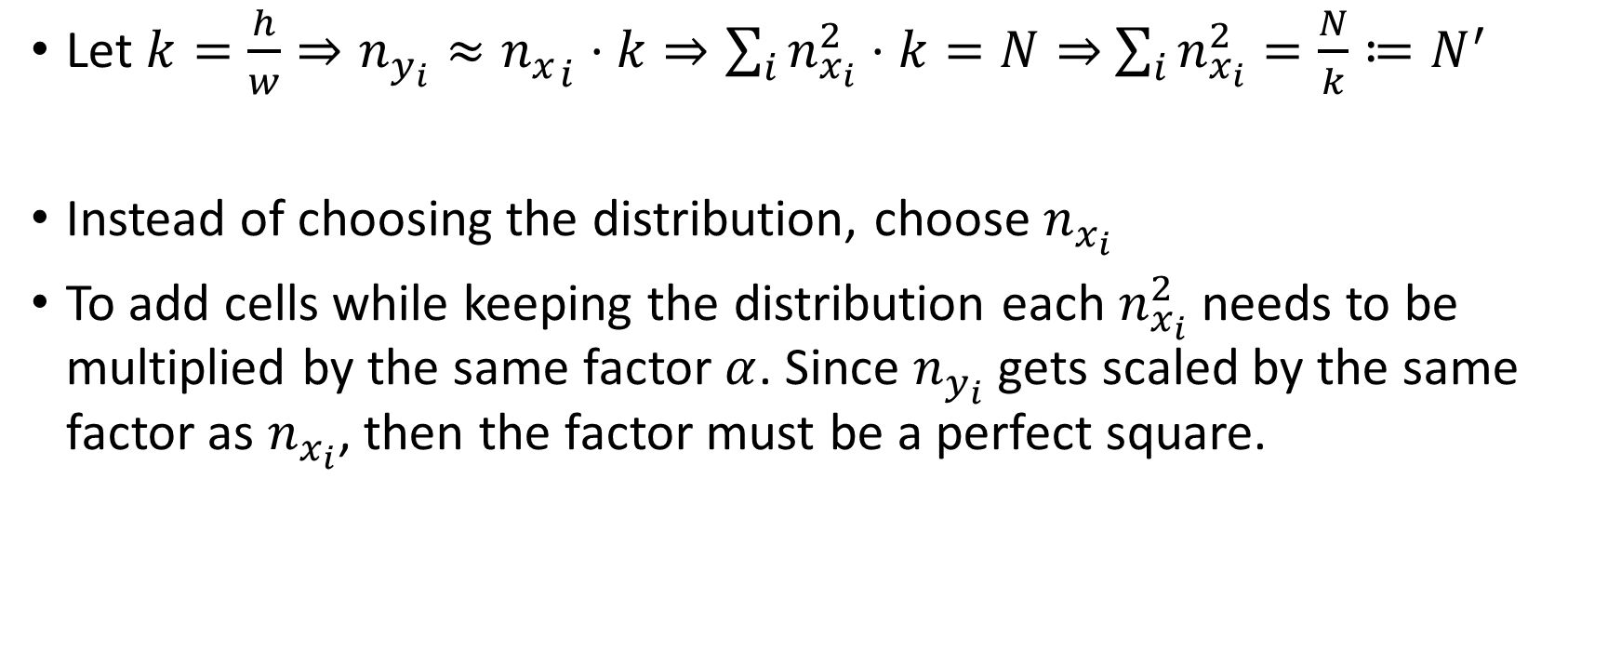
Issue 1 – possible method 4
Let $k=\frac{h}{w}⇒n_{y_{i}}≈{n_{x}}_{i}⋅k⇒\sum_{i}{n_{x_{i}}^{2}⋅k}=N⇒$ $\sum_{i}{n_{x_{i}}^{2}}=\frac{N}{k}≔N^{′}$
Instead of choosing the distribution, choose $n_{x_{i}}$
To add cells while keeping the distribution each $n_{x_{i}}^{2}$ needs to be multiplied by the same factor $α$. Since $n_{y_{i}}$ gets scaled by the same factor as $n_{x_{i}}$, then the factor must be a perfect square.

Slide 11
Experiment observations
Exploration controlled by bias, bias exponentially decreases to uniform distribution
Bias used (preference of keeping same course of action) makes the rat have preference for moving along side walls.
V diverges, but path converges. Once path of close places converge, since V diverges, places further away will try to use routes that have already converged since V in those routes is diverging, whereas the other routes are kept constant.

Slide 12
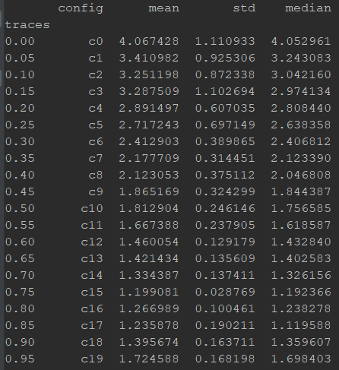
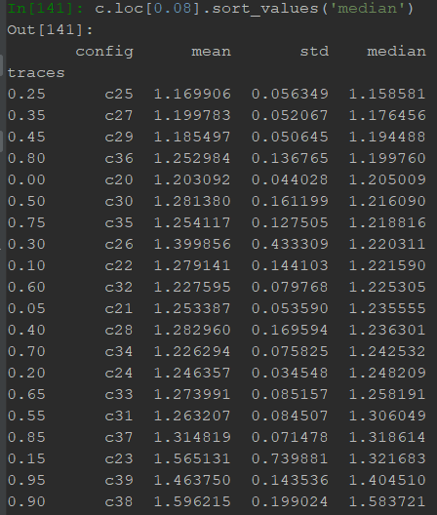
Experiment observations
OBS: after plotting the values I’m not so sure of all the following observations
Calibration:
Smallest scale – does not have enough time to converge if not using traces, does best traces are around 0.75-0.85, and performance increases
At scale 0.08 there doesn’t seem to be much difference in performance (the difference is in convergence time). Only observation is that performance decreases when traces are above 0.8

Slide 13
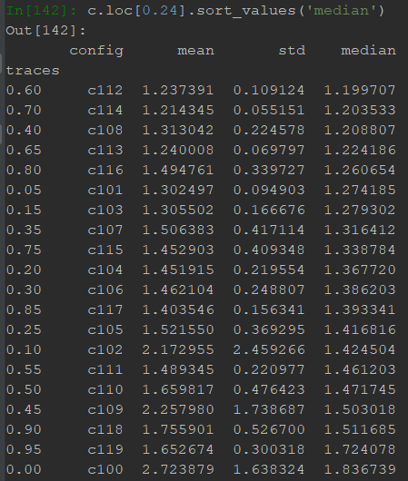
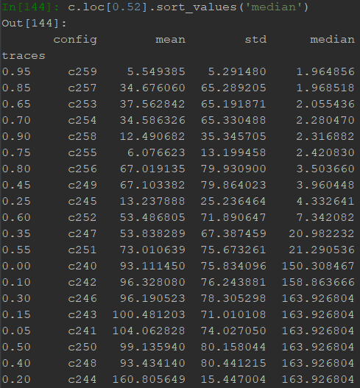
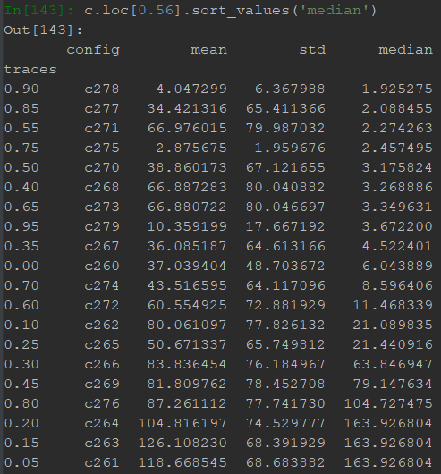
Experiment observations
Calibration:
Smaller scales – for smaller scales, when the coarseness doesn’t affect the quality of the solution, traces are similar to the result for 0.08. Not much difference is observed, except for high traces that degrade performance.
Higher scales – as scales become to coarse, performance degrades and the rat gets caught in back and forth loops. High traces help break the loops sooner. For very big scales, this loops become more frequent and the highest traces are preferred.

Slide 14
Experiment observations
Calibration:
Traces become less and less important as pc size increases.
At scale 0.16 it has almost no effect in convergence speed

